Slide 1
Real Time Sign Language detection
Machine Learning Project
Group :
Akash Nigam : 191070050
Sanket Yele : 191070078
Himanshu Pawar : 191070055

Slide 2
Problem Statement :
A practical implementation of sign language estimation using an LSTM NN built on TF Keras.
Goals - Real time sign language detection using sequences.
Extract holistic keypoints.
Train a LSTM DL model.
Make real-time predictions using sequences.

Slide 3
How does it work?
Collect key points from mediapipe holistic.
Train a deep neural network with LSTM layers for sequences.
Perform Real time sign language detection using OpenCV

Slide 4
Dependencies used :
Tensorflow - an open-source library developed by Google primarily for deep learning applications.
Mediapipe - a ML solution for high-fidelity body pose, face, hand tracking .
OpenCV - an open source computer vision and machine learning software library.
Sklearn - provides tools for machine learning and statistical modeling including classification, regression, clustering and much more.
Matplotlib - a cross-platform, data visualization and graphical plotting library for Python and its numerical extension NumPy.

Slide 5
Mediapipe Holistic

Slide 6
Flow of project :
Import and Install Dependencies.
Keypoints using MP Holistic.
Extracting Keypoint Values.
Setup Folders for Collection.
Collect Keypoint Values for Training and Testing.
Preprocess Data and Create Labels and Features.
Build and Train LSTM Neural Network.
Make Predictions.
Evaluation using Confusion Matrix and Accuracy.
Testing in Real Time.

Slide 7
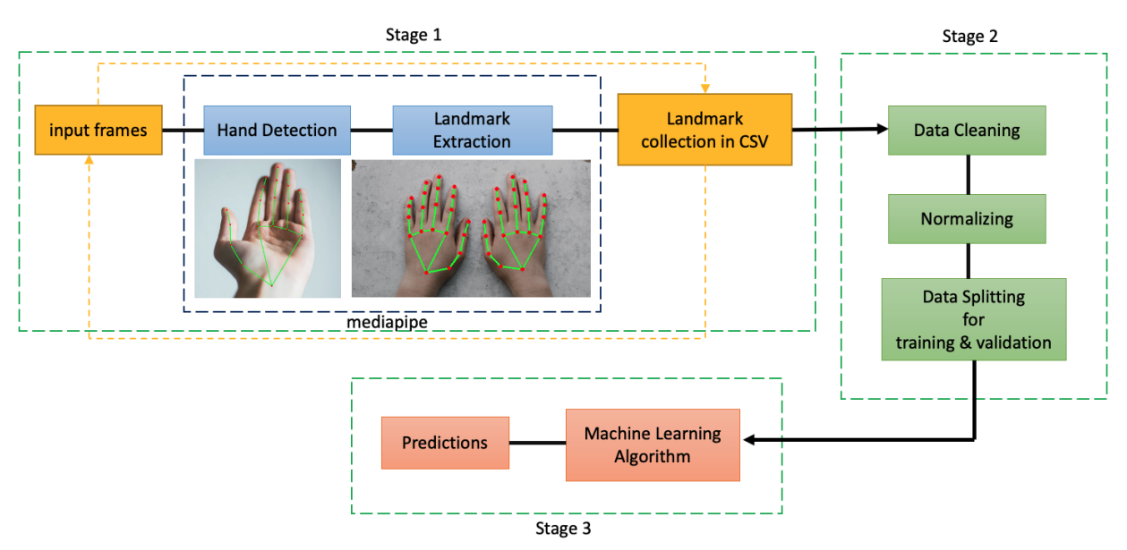
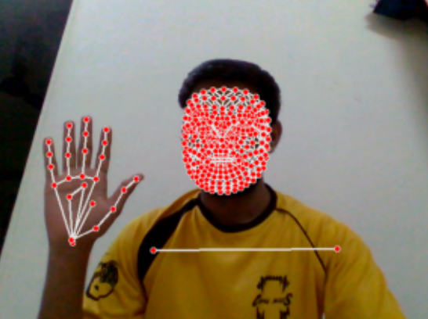
Architecture :
Pre-Processing of Images to get Landmarks using MediaPipe

Slide 8
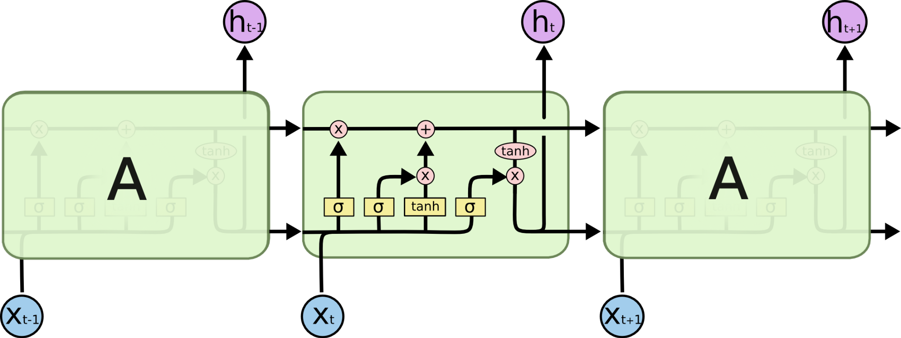
Prediction using Machine Learning Algorithm :
Long-Short-Term memory (LSTM)

Slide 9
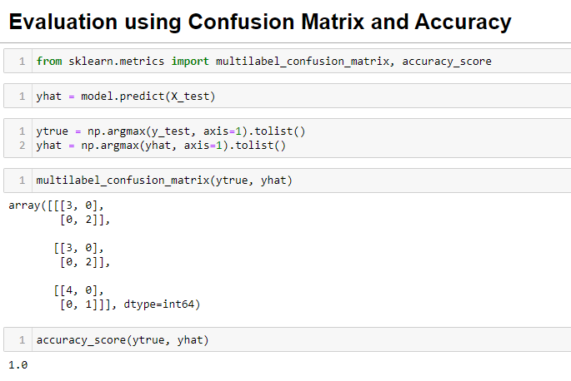
Accuracy of model :

Slide 10
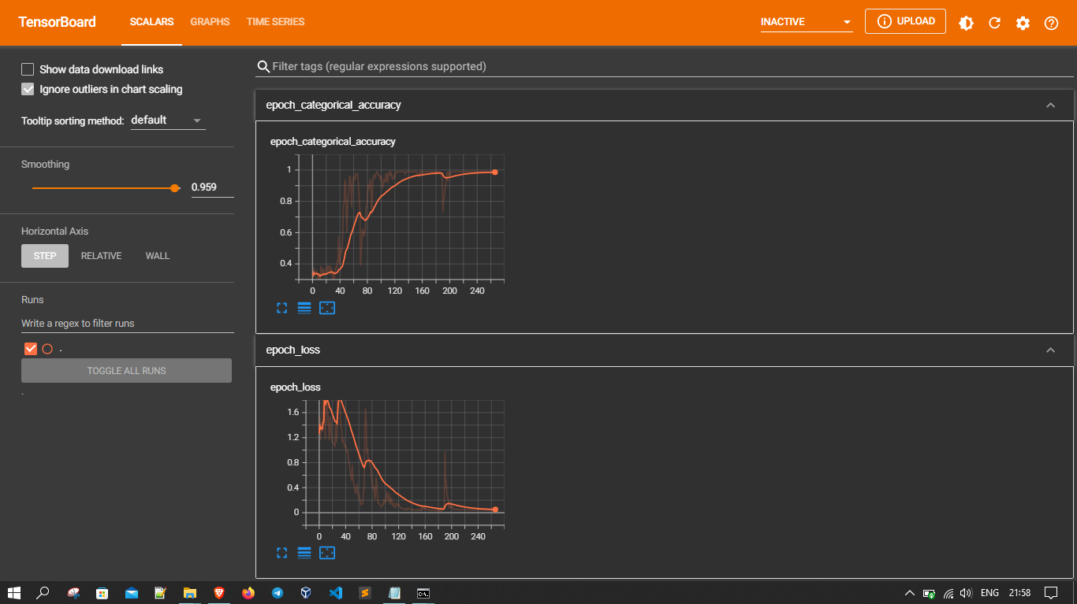
Tensorboard :

Slide 11
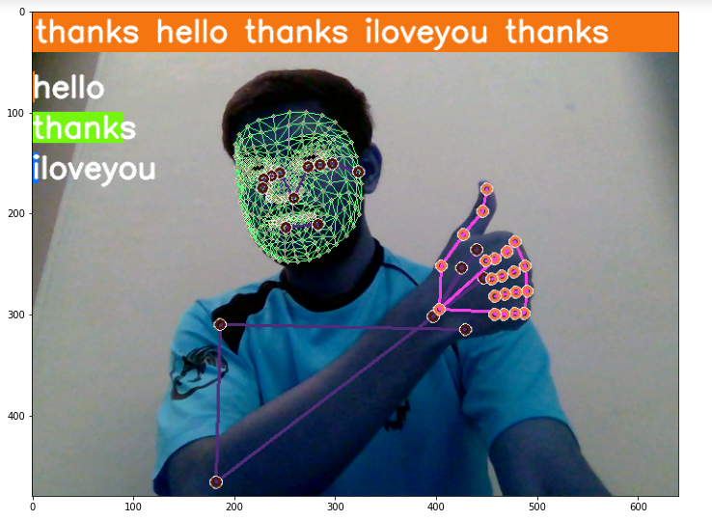
Output : Real-time sign language detection :

